Slide 1
Oktoberfest EDA
for Budweiser
By: Rachel and Santiago

Slide 2
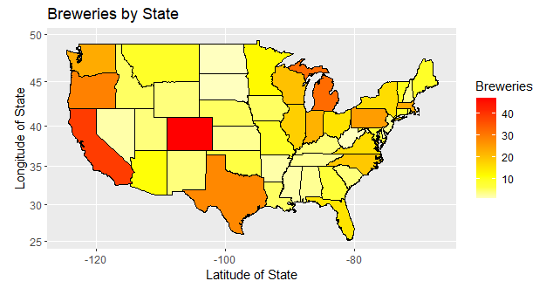
Question 1
How many breweries are present in each state?
Below, one can clearly see how many breweries exist in each state.

Slide 3
Question 3
Address the missing values in each column.
The ABV column appears to have 62 missing values, which equates to 2.5% of total values.
The IBU column appears to have 1,005 missing values, which equates to 42% of total values.
The missing ABV values will have little effect on our results, whereas the missing IBU values will have a much greater effect on our results.

Slide 4
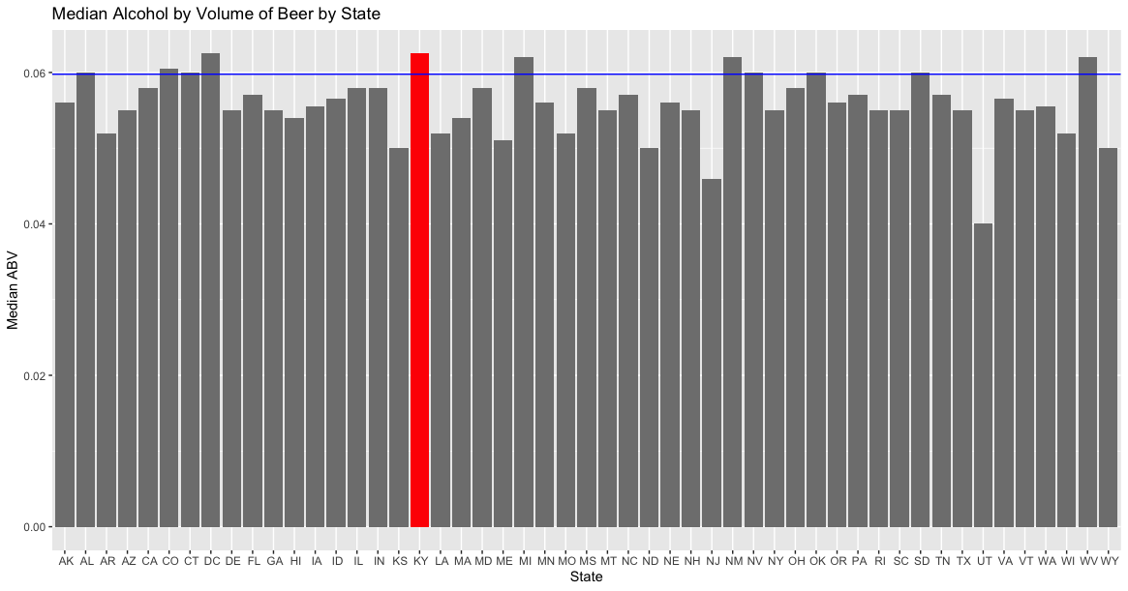
Question 4
#1 Highest Median ABV is Kentucky.

Slide 5
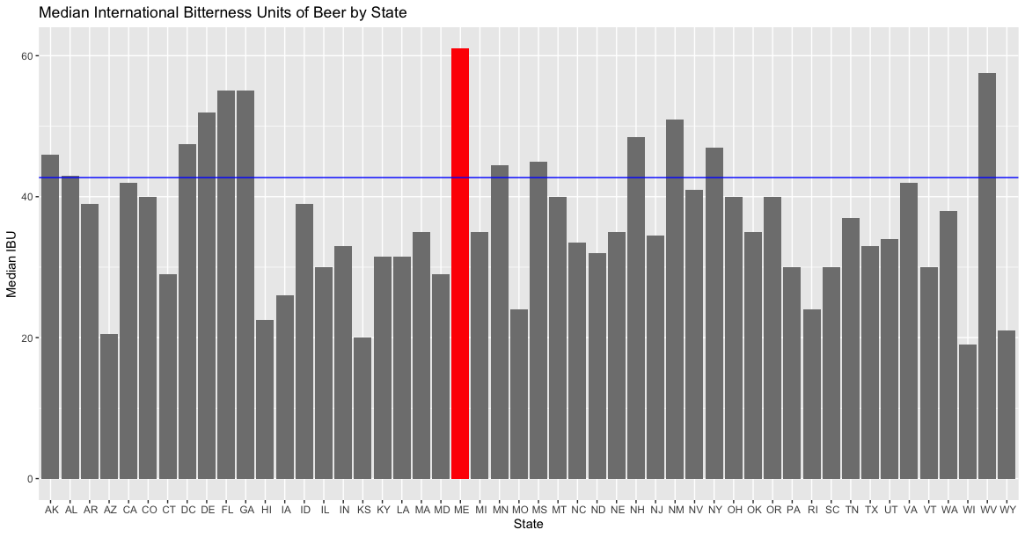
Question 4
#1 Highest Median IBU is Maine.

Slide 6
Question 5
Which state has the maximum alcoholic (ABV) beer? Which state has the most bitter (IBU) beer?
Colorado appears to have the maximum alcoholic (ABV) beer with a % alcohol content at 12.8%.
Oregon appears to have the most bitter (IBU) beer with a bitterness level at 138 IBU.

Slide 7
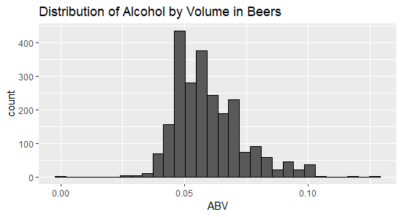
Question 6
Summary Statistics
As mentioned, our ABV data includes 62 missing values.
The median ABV appears to be 0.056 and the mean ABV appears to be 0.05977.
The beer with the highest alcohol content has about 12.8% alcohol content (found in Colorado) and the lowest has 0.1% alcohol content. Colorado has more than twice as much alcohol content as the mean, which is intriguing given that the effects of alcohol are felt much more at higher altitudes.

Slide 8
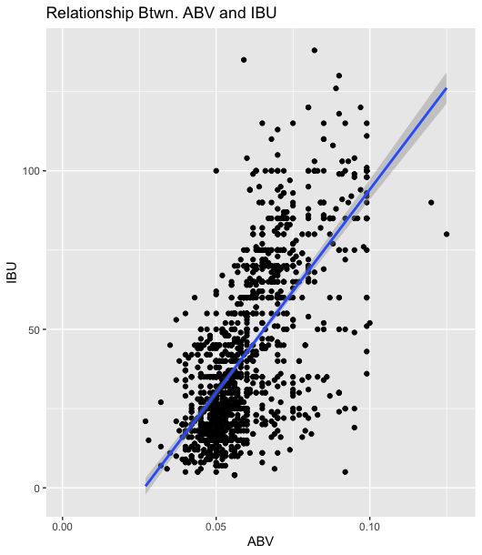
Question 7
Is there any apparent relationship between the bitterness of the beer and its alcohol content?
Draw a scatter plot.
Our scatterplot and regression line suggest that there is a positive correlation between ABV and IBU.
Using ggpairs, we also obtained a correlation coefficient of +0.671 which supports our claim.
Based on our findings, we can infer that an increase in ABV is associated with an increase in IBU (or, vice versa).

Slide 9
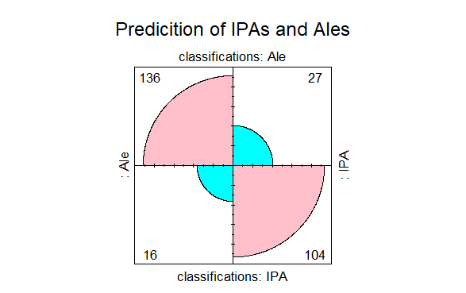
Question 8
Can we predict IPAs vs. Ales based on ABV and IBU?
Statistical evidence suggests yes.

Slide 10
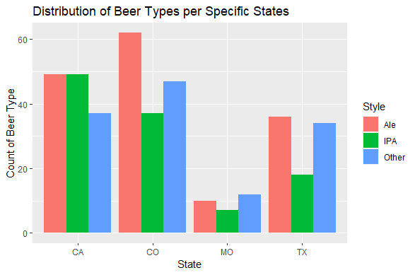
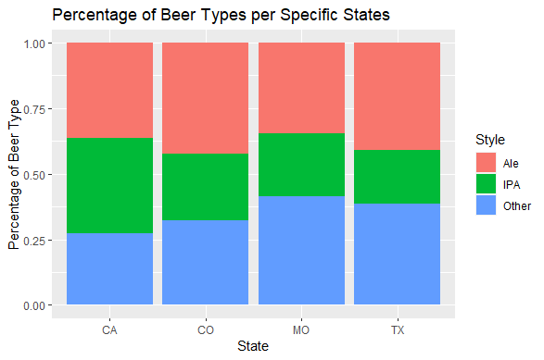
Question 9
Ales vs Other Beers

Slide 11
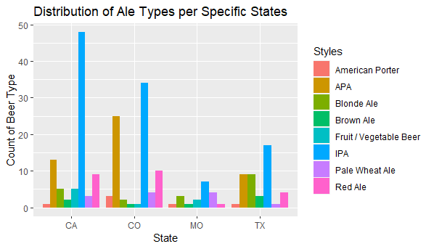
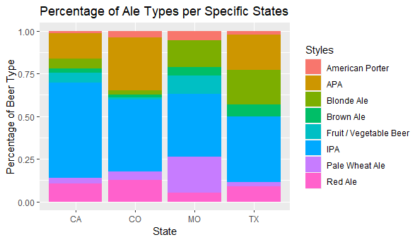
Question 9
Ale Distribution

Slide 12
Questions?

Slide 13
Thank you!
Rachel Liercke Santiago Gutierrez
rachel.liercke@gmail.com santigtz95@gmail.com

Slide 14
Youtube Presentation
https://www.youtube.com/watch?v=47FJX-wTjNc

